Slide 1
Shed Style Architecture
By Cody Turner

Slide 2
Shed Style Architecture
It emerged in the 1960s and 70
One to two stories
Typically residential
Common in the western and southwestern U.S.
The materials varied are wood, stone, and textured concrete

Slide 3
Shed Style Basic Design
Shed style home roofs typically have wood shingles, and have many slopes and directions with no effort towards symmetry
Has a rustic and woodsy characteristics
Doors are recessed and has small windows

Slide 4
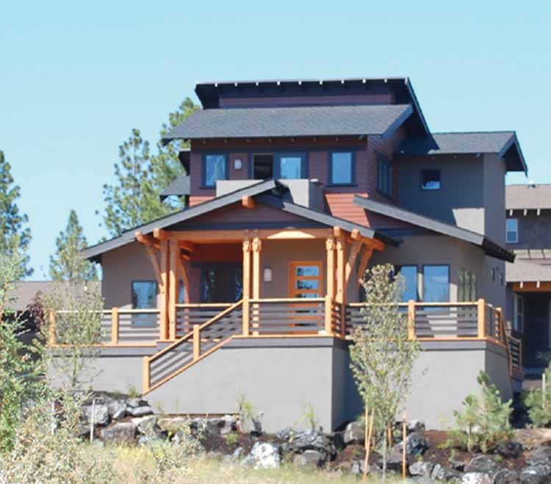
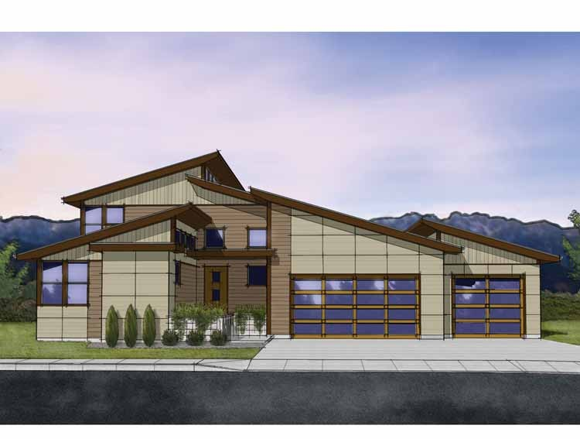
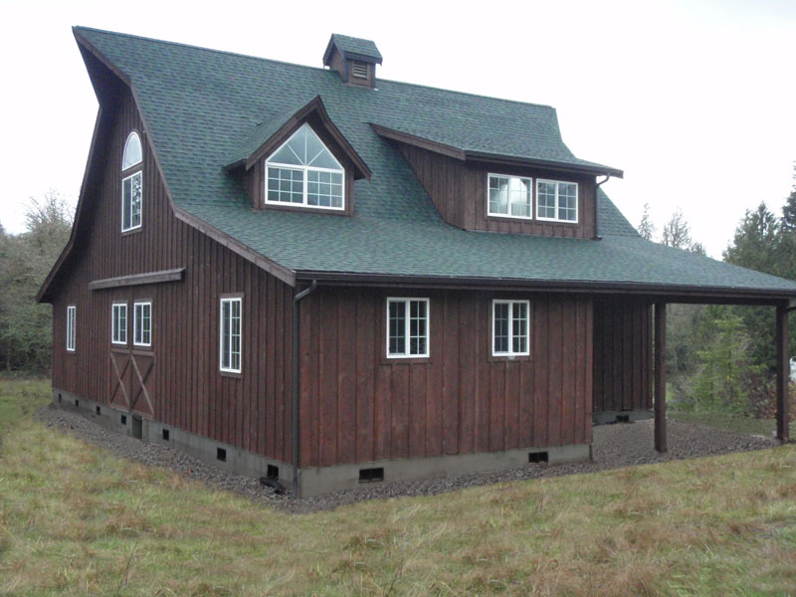
Shed Style characteristics
Recessed door and small windows
Different slopes and directions for the roof
Wood siding and shingles. Also has a concrete foundation

Slide 5
Work cited
Facts on Shed Style Homes (2011) Retrieved August 6 2013, from https://pltw.instructure.com/courses/141825/assignments/936259?module_item_id=2055853

